Slide 1
PEY Panel
Prachi Ray – Clinical Trials Unit at the Applied Health Research Centre (AHRC – Unity Health Toronto)
Angela Zhou – Karp Lab at the Brigham and Women’s Hospital, Harvard Medical School
Jay Paranjpe – Sanofi Pasteur
Daria Oleinichenko – Singh Lab at McMaster University
Emily Mathers – Procter & Gamble (P&G)

Slide 2
Prachi ray
Research assistant, clinical trials unit at the applied health research centre (AHRC – Unity health Toronto)
Applied to 8 postings through the Career Portal – Interviewed for 3 positions and received 1 offer mid-May
Clinical Trials Unit:
1 Manager, 12 Project Managers, 2 Research Assistants
Email: prachi.ray@mail.utoronto.ca
Feel free to reach out if you have any questions!

Slide 3
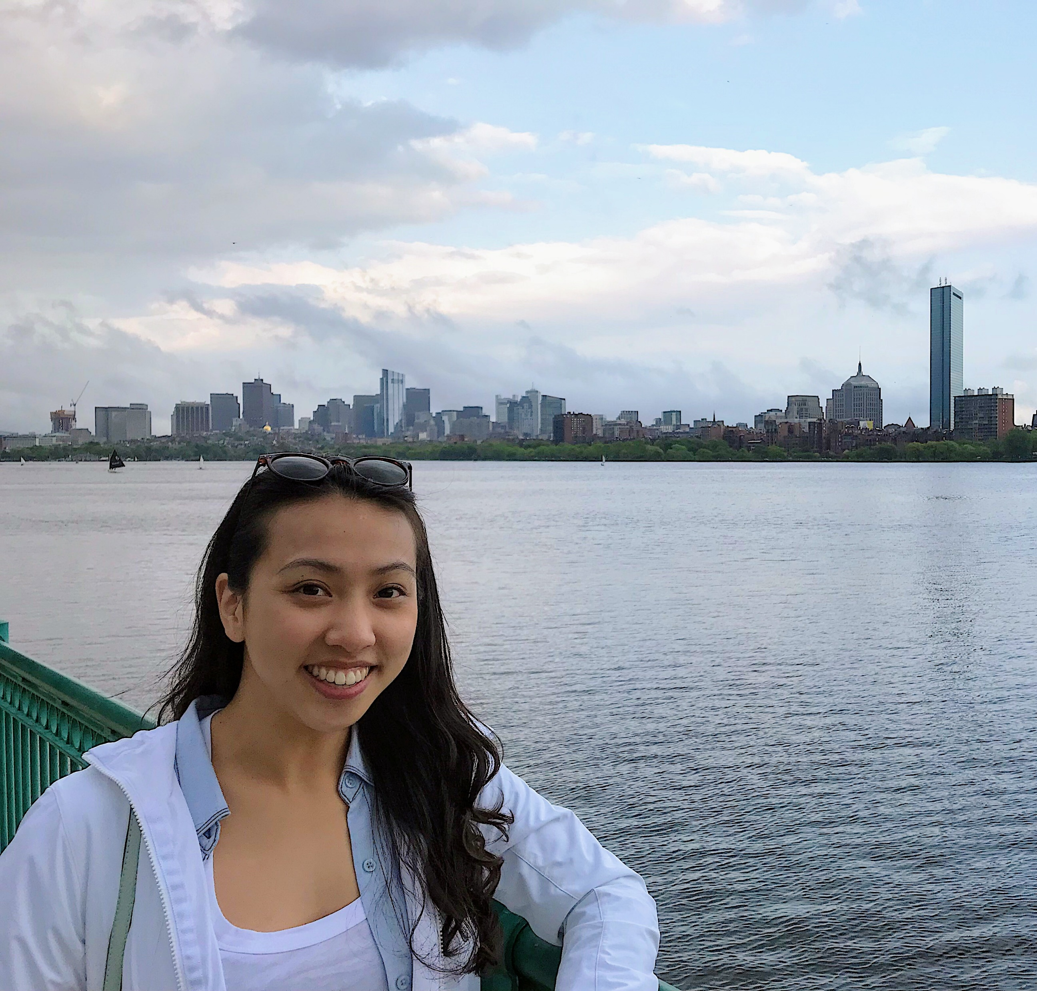
Angela zhou
Karp lab at brigham and women’s hospital, Harvard medical school
Pharmacology specialist
PEY placement 2019 - 2020: Karp Lab at Brigham and Women’s Hospital, Harvard Medical School
Worked in a biomedical engineering lab
Focused on solving unmet needs in type 1 diabetes treatments – mixture of pharmacology, biomaterials, and stem cell biology
Application process (January – February 2019 – wave of Harvard and MIT PEY positions)
Cover letter, resume, interview
Explain research interests or what areas of research you want to explore
Email: angelaz.zhou@mail.utoronto.ca

Slide 4
Jay Yuan Paranjpe
Mtech Co-op student, Sanofi pasteur
Pharmacology Specialist
Cell & Molecular Biology Specialist
Applied for 10 positions on the portal
2 interviews
Offer Received mid-February
Knowledge management of antigen manufacturing processes
Designing diagrams that visualize process parameters for use in training/investigations
Facebook: facebook.com/JayYuanParanjpe
Email: jay.paranjpe@mail.utoronto.ca

Slide 5
Daria oleinichenko
Singh lab at Mcmaster university
About me:
Pharmacology Specialist, final year.
Interested in neuropharmacology,
Future goal to pursue research in academia (I’ll let you know how it goes :)
Fun fact: It was a lucky coincidence that I chose to do science but I would probably do research regardless of my field of study.
My job search experience:
Knew my goals and interests.
Tried applying through the ECC system.
Used my network to get the placement I wanted – not in Toronto, preclinical work, academic lab.
My placement:
I learned so much!
Project on influence of gonadal hormones on neuropathic pain in a rat model.
Core skills I developed: communication, data analysis, literature research, logistical planning, troubleshooting.
Advice:
Be confident, yet flexible.
Leverage your network and prior experiences.
Contact me if you have questions! daria.oleinichenko@mail.utoronto.ca
Notes:
yourself, your experiences in applying to PEY, where you worked and what you did/are doing during your placement for approx. 5 min.

Slide 6
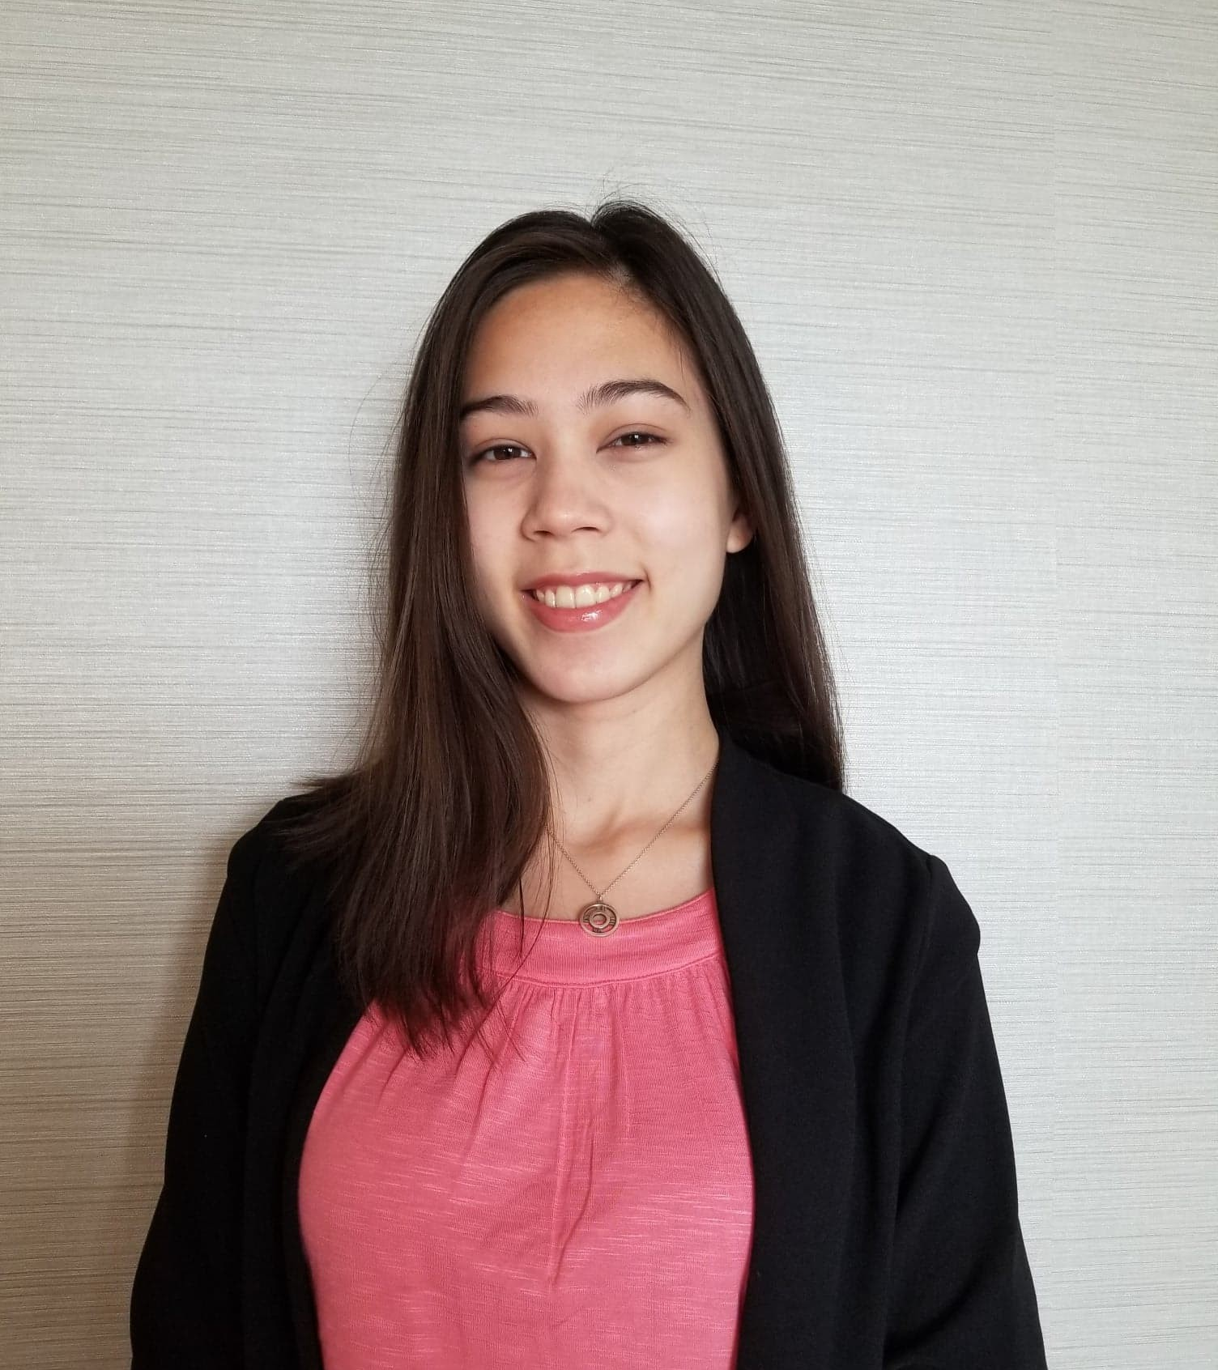
Emily Mathers
Regulatory Affairs Intern, P&G
Pharmacology specialist
Applied for 15 positions on the portal
~5 interviews
Received 1 offer mid-August
Product assessments for human & environmental safety
Approving new products for sale/marketing based on chemical data and Health Canada regulations
Contact: emily.mathers@mail.utoronto.ca

Slide 7
Questions?
Prachi Ray – Clinical Trials Unit at the Applied Health Research Centre (AHRC – Unity Health Toronto)
Angela Zhou – Brigham and Women’s Hospital, Harvard Medical School
Jay Paranjpe – Sanofi Pasteur
Daria Oleinichenko – McMaster University
Emily Mathers – Procter & Gamble (P&G)

